Slide 1
Weight loss, social life and sexuality
Dott.ssa fanni guidolin
Enterostomal therapist specialized in pelvic floor rehabilitation and sexual counseling nurse
Castelfranco veneto (treviso)

Slide 2

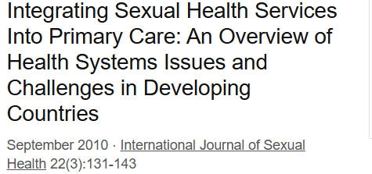
We all desire a pleasurable sexuality in a health body to feel happy in the world and in relationship with others
We all desire a pleasurable sexuality in a health body to feel happy in the world and in relationship with others

Slide 3
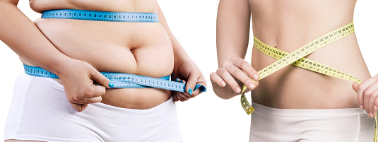
This is not always possibile
Losing voluntary weight
Losing not voluntary weight

Slide 4

Basson, R. (2000) «A Model of Sexual Response»
Journal of Sex & Marital Therapy, 26(1), 1-17
Voluntary Weight loss can improve social life and sexuality as enchance self efficacy and body image promote more satisfying relationships and greater intimacy
Losing weight involuntarily means having to deal with an anarchic body and the psychological battle is more difficult

Slide 5

Duncan, R.E. & Al Rubaish, A. (2017) «The Impact of Obesity on Sexual Function: a review of the current literature» The Journal of Sexual Medicine, 14(3), 100-107
Women who lose weight experience greater benefits on their sexuality and social life than men as there are greater implications on the female pelvic floor

Slide 6
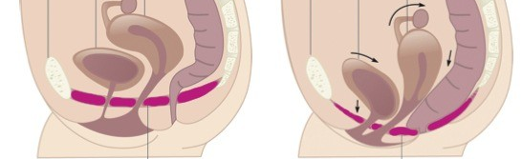
Pelvic Floor centred patient
Sometimes starting with pelvic floor dysfunction as a reason to encourage a patient to lose weight or to accept their body losing weight for improved sexuality can be more effective than simply focusing on losing weight for health reasons
Pereira L.V. et al. 2017 «impact of obesity on pelvic floor dysfunction: a narrative review» International Urogynecology Journal , 28 (5), 747-754

Slide 7
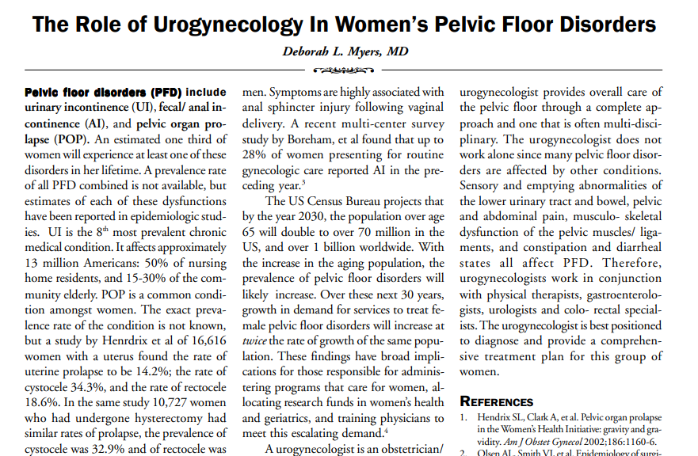
ACOG Committee Opinion No. 749 (2018). "The Role of the Urogynecologist in the Care of Women with Pelvic Floor Disorders." Obstetrics & Gynecology, 132(4), e120-e123.
Pelvic floor strengthening exercises can improve sexual satisfaction and reduce erectile dysfunction.

Slide 8
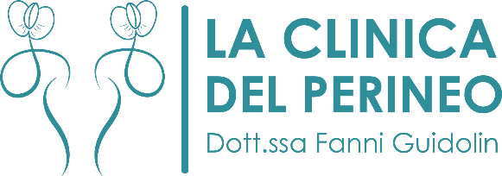
Case Study in my Clinic : 1629 patients from 2023 to 2025
Men : 58
Women : 1571
26 with a BMI from 25 to 29,9
(46%) as the WHO report
Urinary incontinence
Erectile disfunction
altered social life
518 with a BMI from 25 to 29,9
(33%) as the WHO report
Urinary incontinence, dyspareunia, pelvic organ prolapse
hypoactive desire disorders
altered social life

Slide 9
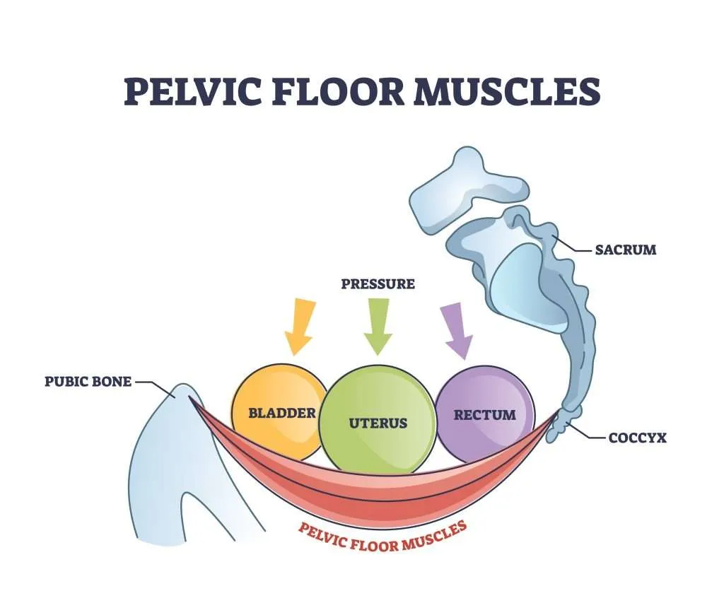
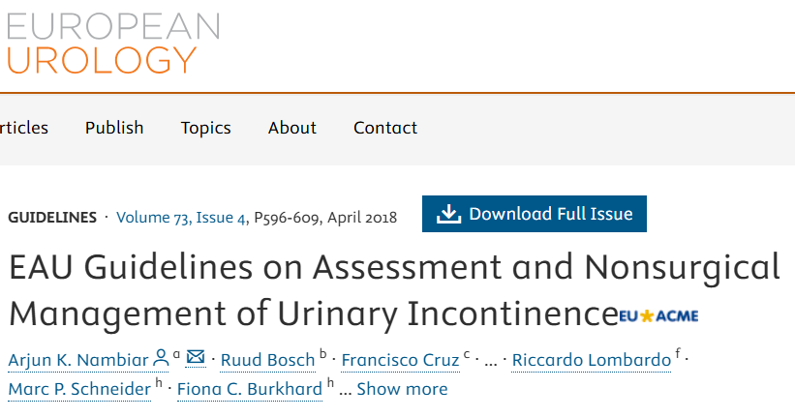
Combining pelvic floor re-education with weight loss can improve the quality of your sexual life and social relationships
ACOG Committee Opinion No. 749 (2018). "The Role of the Urogynecologist in the Care of Women with Pelvic Floor Disorders." Obstetrics & Gynecology, 132(4), e120-e123.
- Dietz, H.P. (2018). "The role of pelvic floor dysfunction in the management of urinary incontinence." European Urology Supplements, 17(3), 187-196.

Slide 10
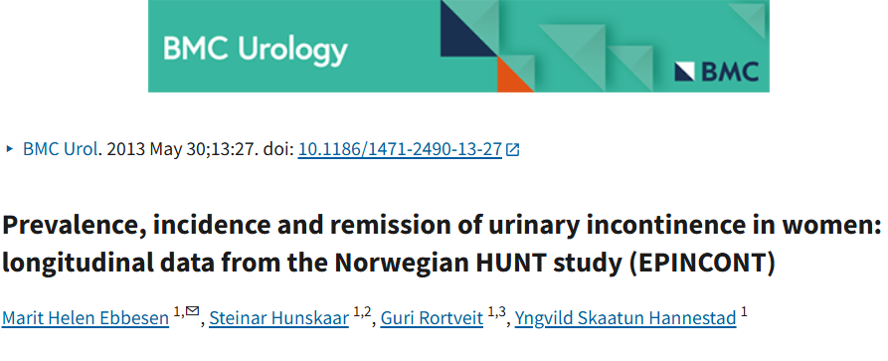
…with a worsening of social life
Weight voluntary loss can relieve pressure on the pelvic structures, improving urinary and sexual function.
But losing excessive weight involuntarely can make it difficult to recruit the sphincter muscles responsible for urinary and fecal continence.

Slide 11
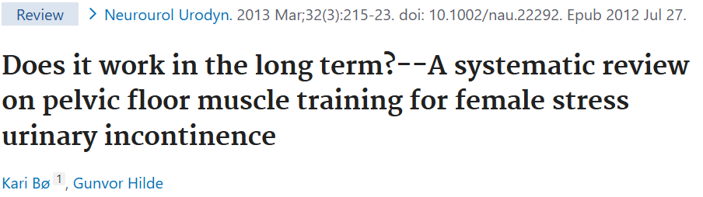
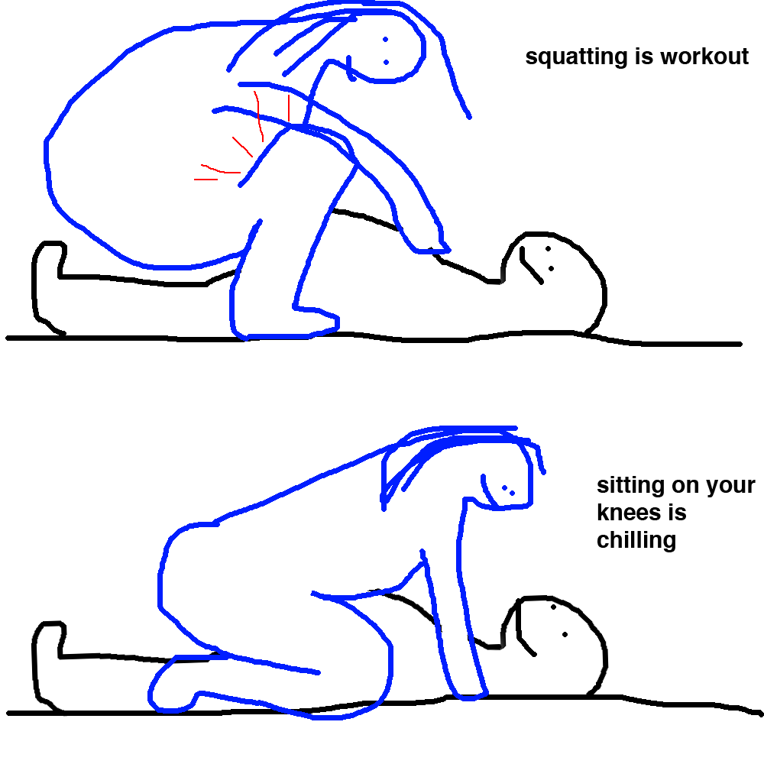
Anyway.. weight loss relieve pressure on pelvic structures
Reducing the risk of incontinence (which can occur during sexual activity)
Reducing pelvic pain and dyspareunia
Allowing easier and longer walks in the open air and a consequent increase in libido
Improving the sacroiliac joint and pelvic mobilizations during sex
Allowing the person to experiment with more optimal positions

Slide 12
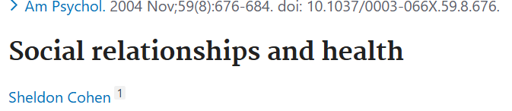
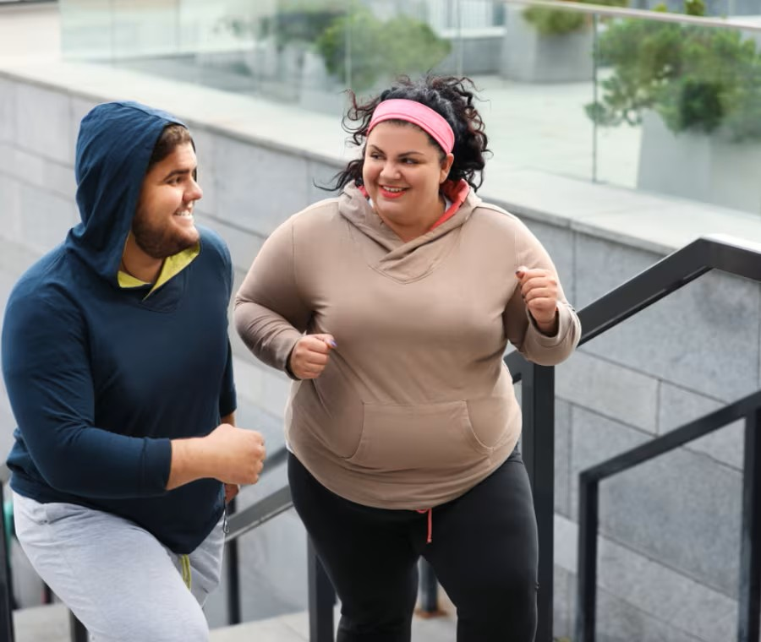
Cohen, S. (2004). "Social relationships and health." American Psychologist, 59(8), 676–684
People who lose weight voluntarily often notice an improvement in their confidence and social relationships.

Slide 13

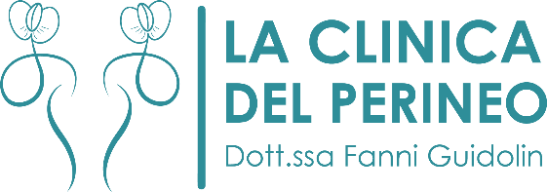
for patients affected by obesity or overweight?

Slide 14

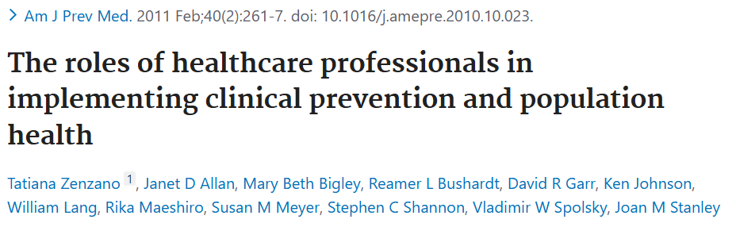
Team Working
Doctors, nurses, nutritionists, dietologist MD and sex therapists must work together
Team Working

Slide 15
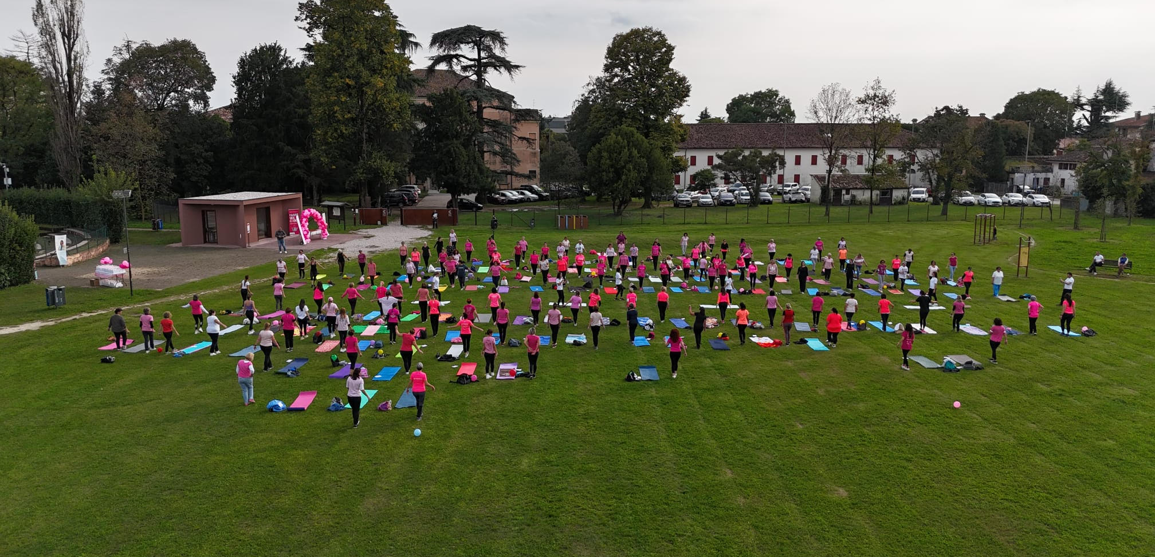
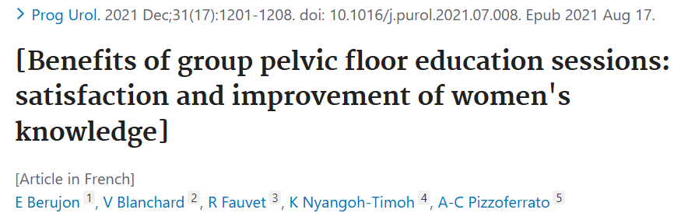
We organize outdoor and group perineal health programs to improve social interactions

Slide 16
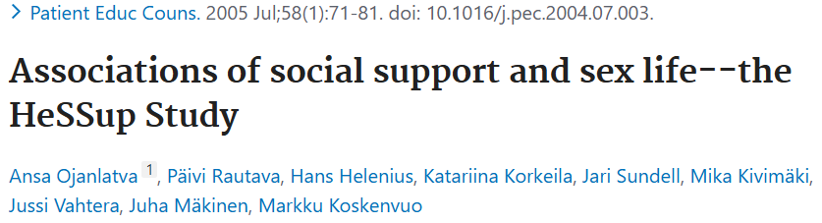
Yelland, C., et al. (2018). "The impact of social support on sexual satisfaction in women." Journal of Sex Research, 55(4-5), 608-617.
Strong social relationships increase sexual satisfaction and the quality of intimate interactions. Social isolation can contribute to sexual dysfunction, such as dyspareunia and decreased libido.

Slide 17

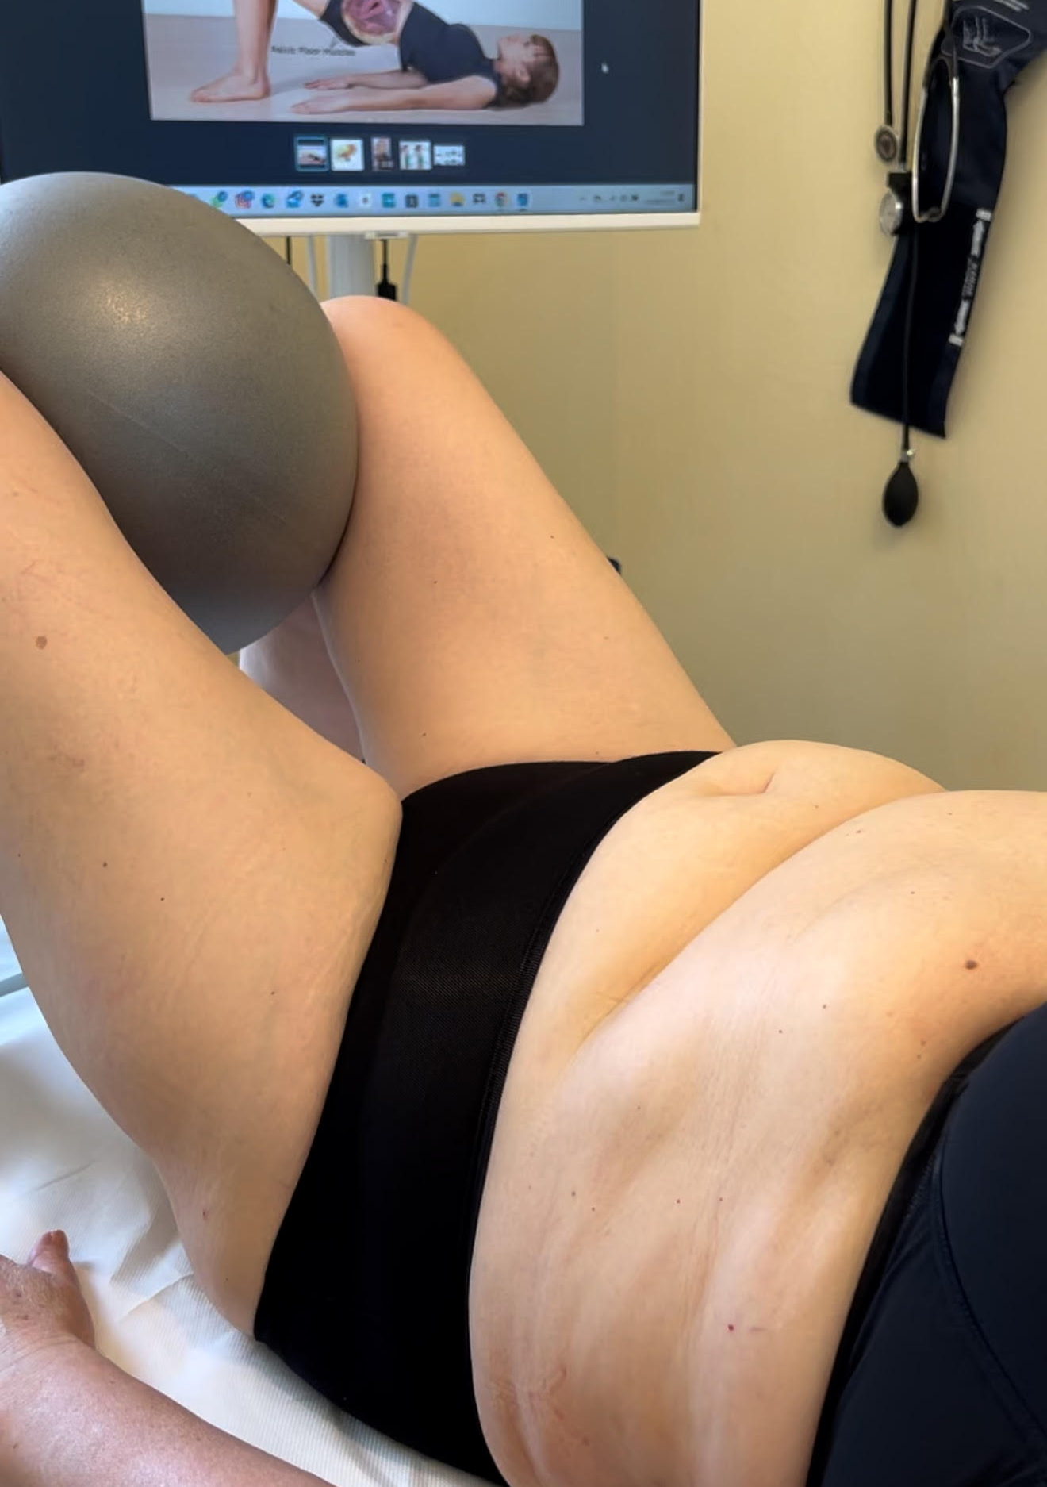
Group rehabilitation activities to encourage connections between patients and personalized program

Slide 18
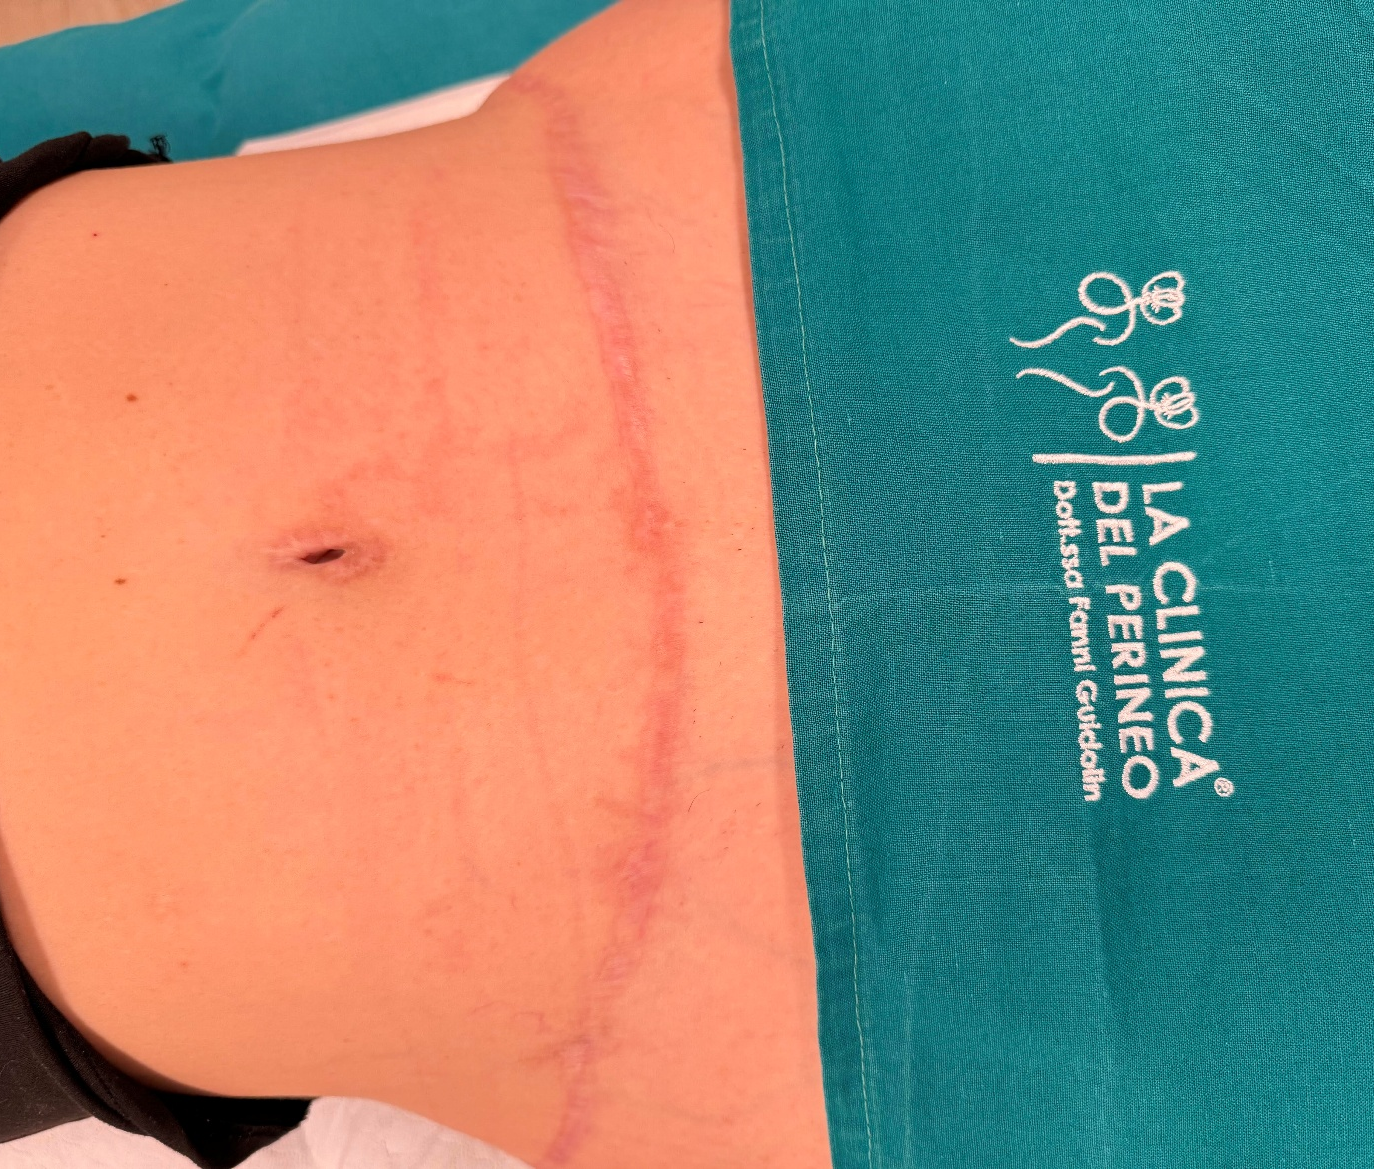
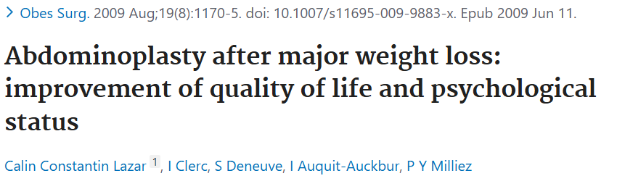
Abdominal and perineal management post abdominoplasty after weight loss

Slide 19
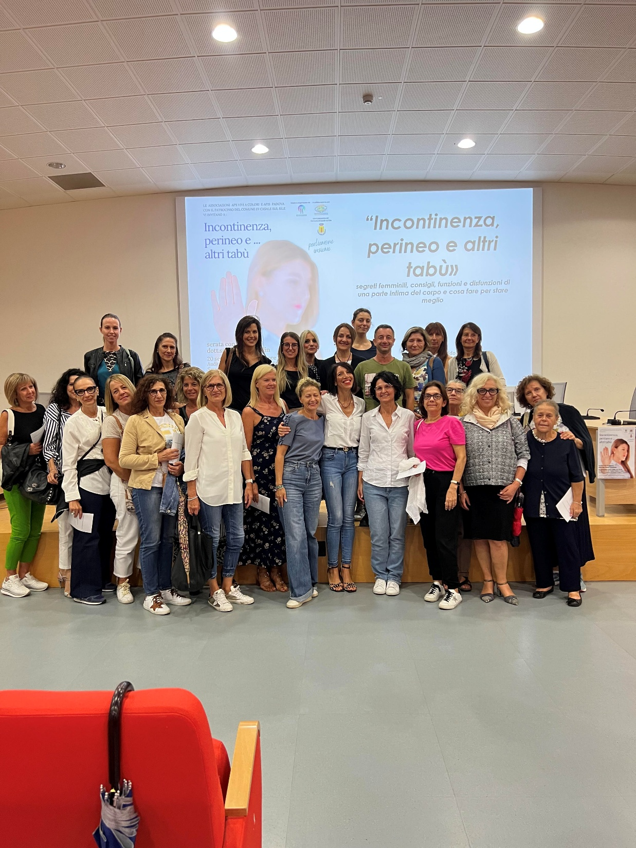
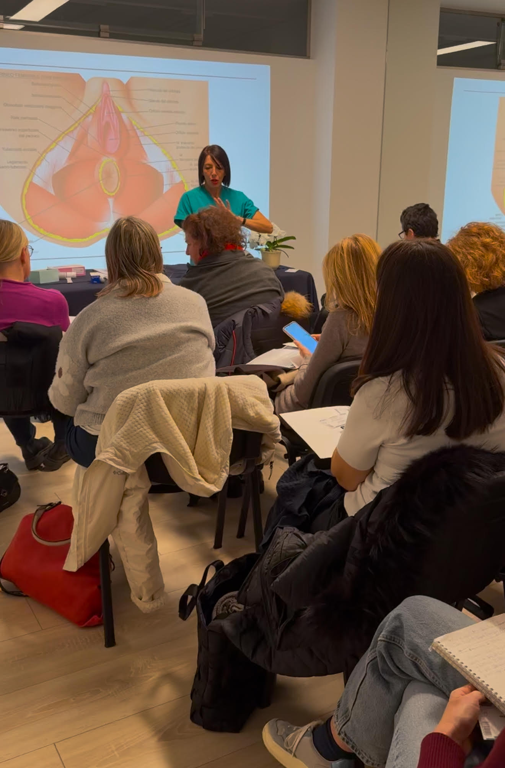
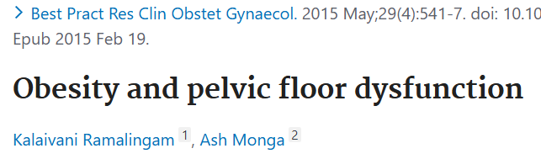
we teach how to recognize the risk factors of sexual dysfunction and pelvic floor dysfunction including overweight and obesity through courses and meetings

Slide 20
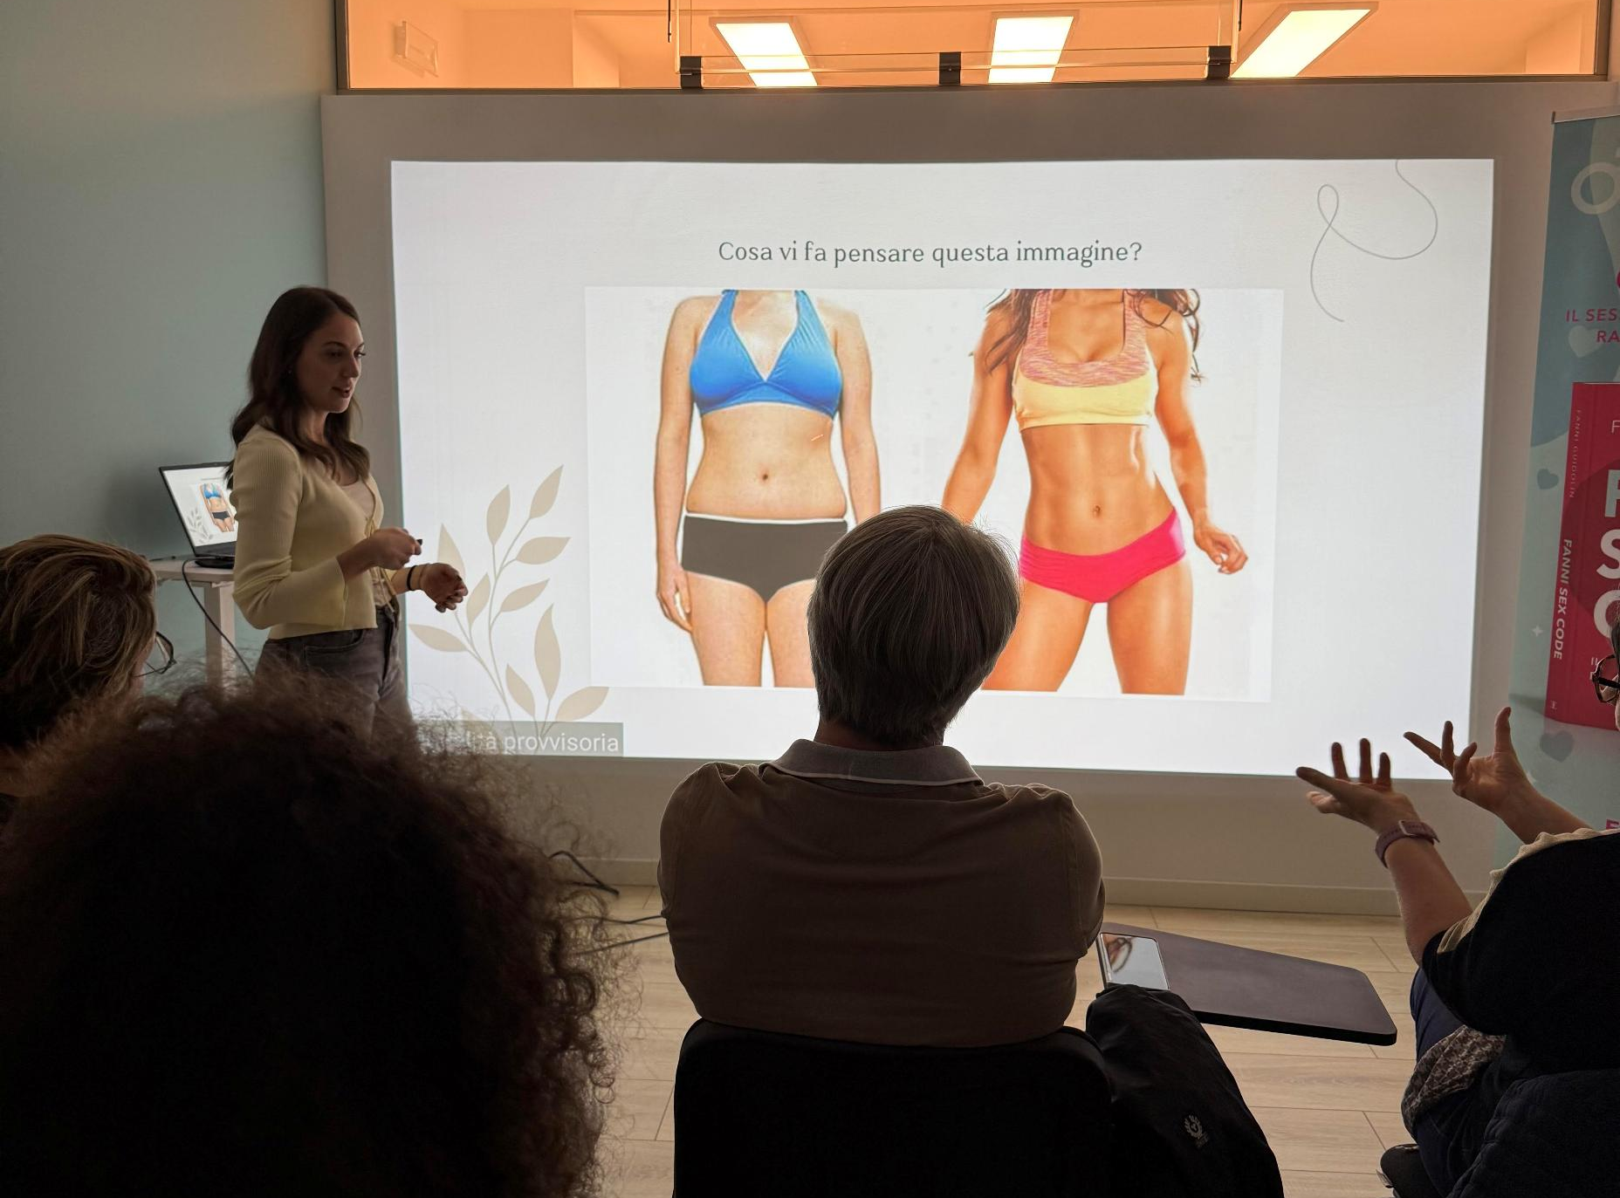
Group meetings to teach assertive communication techniques with partner and reduce anxiety
Depression and anxiety may affect 45% of women with sexual dysfunction (Linke S.E. et al. 2019)

Slide 21
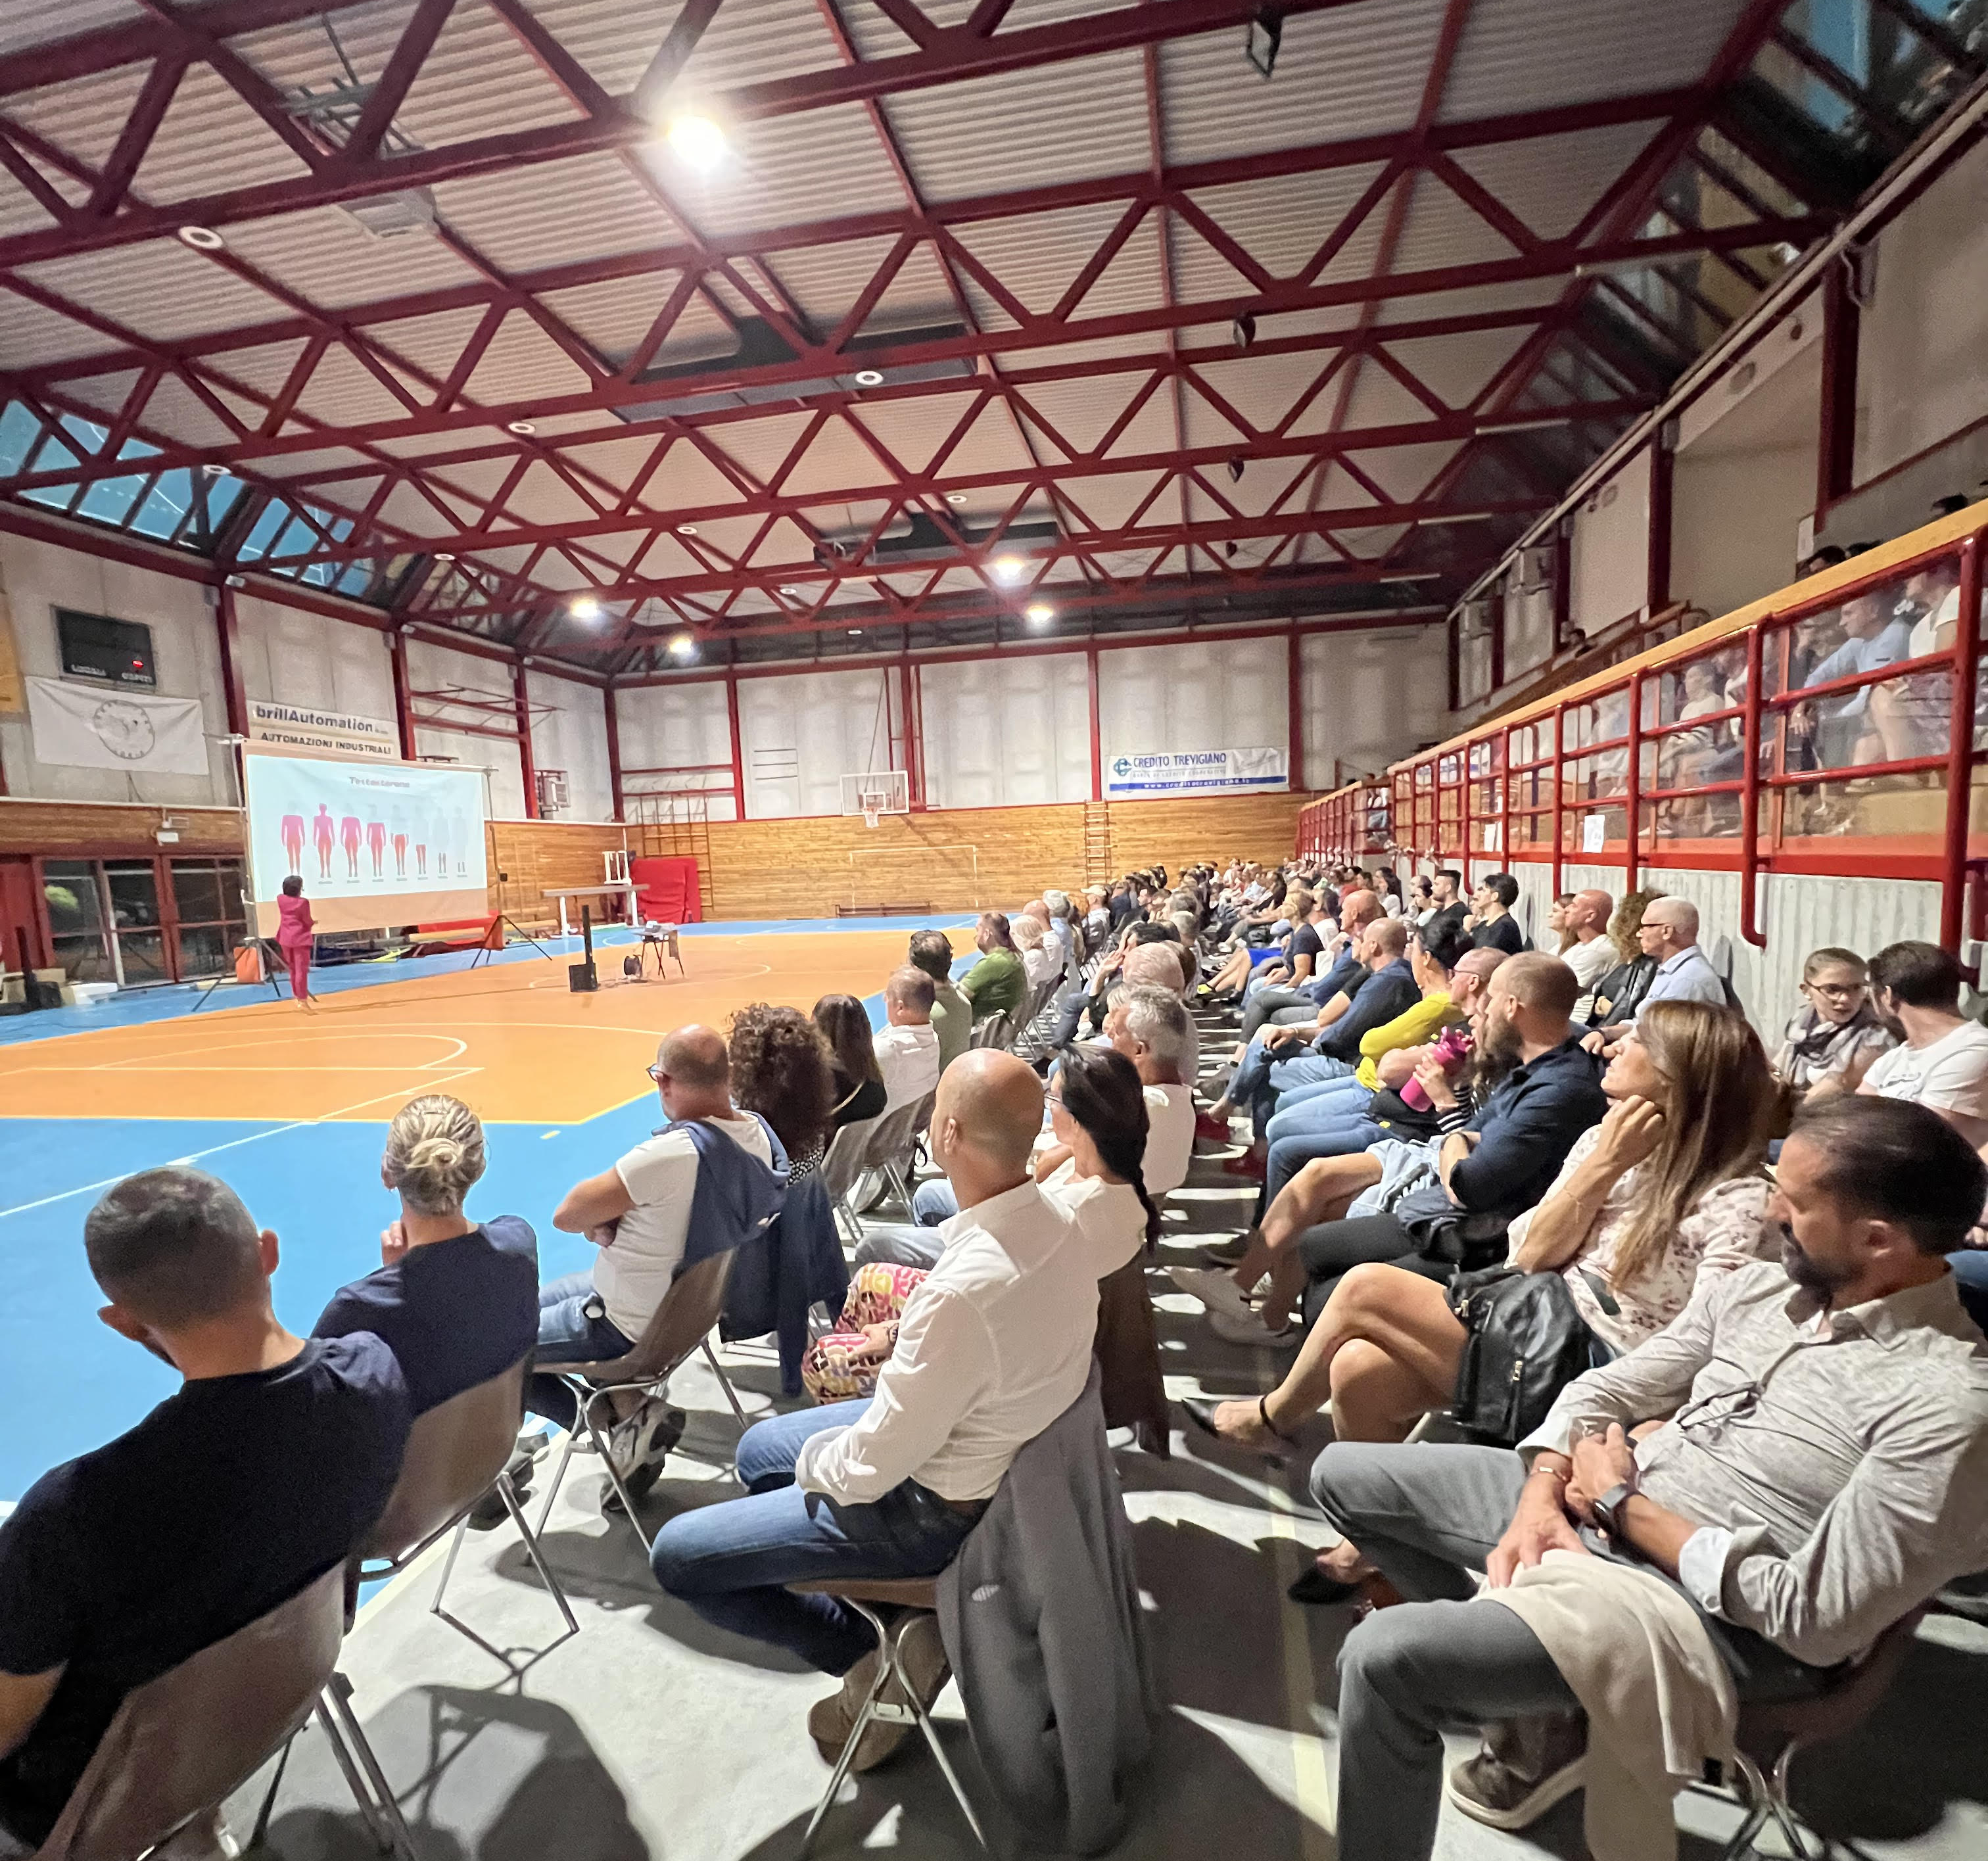
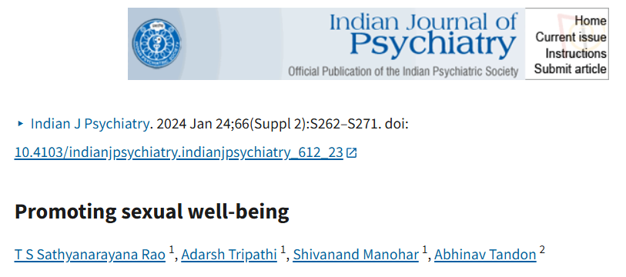
inclusive evenings of sexual education and improvement of couples' sexuality

Slide 22


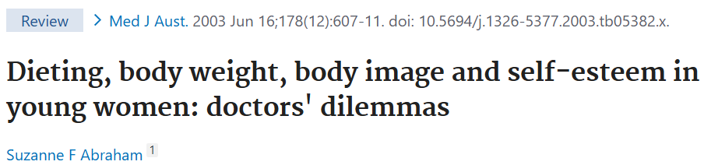
We work on self-esteem and body image after weight loss

Slide 23
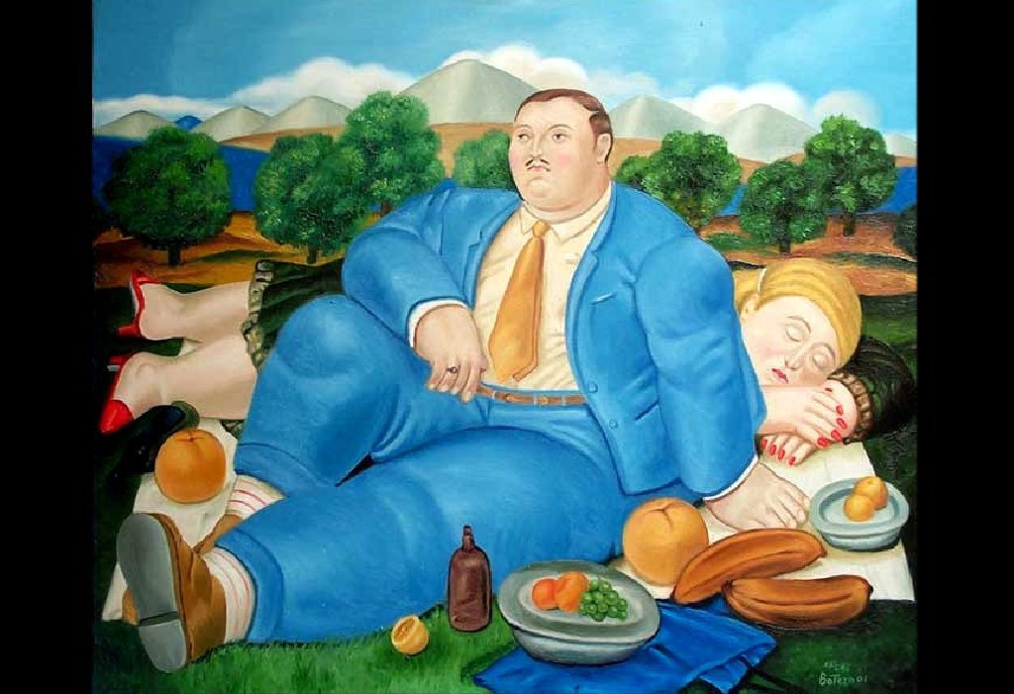
Weight loss, social life, sexuality and… Pelvic Floor

Slide 24
Grazie! info@laclinicadelperineo.it

